Slide 1
ATAI
Advanced Techniqueof Artificial Intelligence
ATAI
ChongqingUniversity _{AdvancedTechniqueof}
of Technology Artificial Intelligence
Chongqing University of
Technology
Chongqing University ^{ATAI}
_{of Technology} Advanced Techniqueof
Artificial Intelligence
Chongqing University of Technology
Chongqing University of Technology
Seeing Beyond Noise: Joint Graph Structure Evaluation and Denoising
for Multimodal Recommendation
Code: None.
2025.6.19 •ChongQing
—— AAAI 2025
Reported by Ling Tan
1

Slide 2
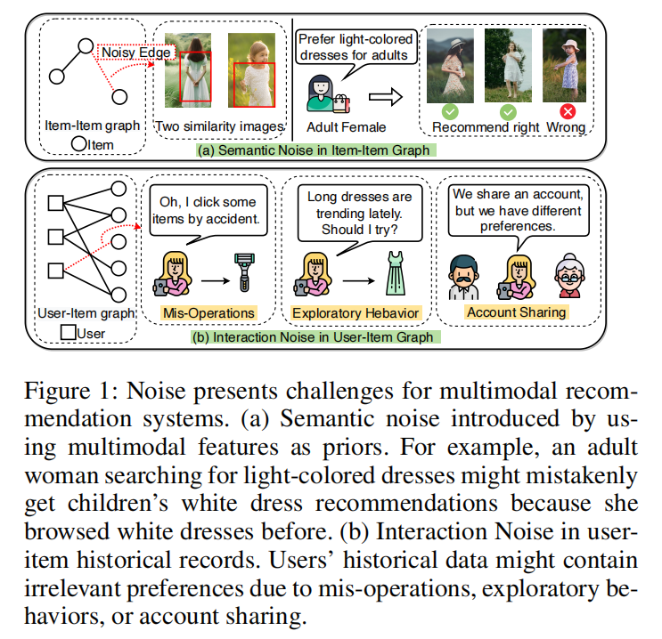
ATAI
AdvancedTechniqueof
Artificial Intelligence
ATAI
ChongqingUniversity _{AdvancedTechniqueof}
of Technology Artificial Intelligence
ChongqingUniversity of Technology
Motivation
（1） Semantic noise: similarity-based item graphs in current models produce inaccurate semantic connections due to preference diversity, the limitations of cosine similarity in high dimensions, and discrepancies in modal distribution, misleading user interest modeling.
（2） Interaction noise: factors like mis-operations, exploratory behaviors, or account sharing introduce noise in user-item interactions, confusing the user interest modeling.
Notes:
语义噪音：
同一物品对不同用户可能有完全不同的语义含义，高维特征空间中所有点对的距离趋于相似，无法有效区分真正相关和偶然相似的项目，不同模态(如视觉和文本)的特征分布存在显著差异，直接合并不同模态的相似度可能导致信息扭曲
交互噪音：用户可能误点击了与真实兴趣相似的商品，探索性行为可能涉及相关但非目标商品，账户共享时不同用户的兴趣可能有部分重叠

Slide 3
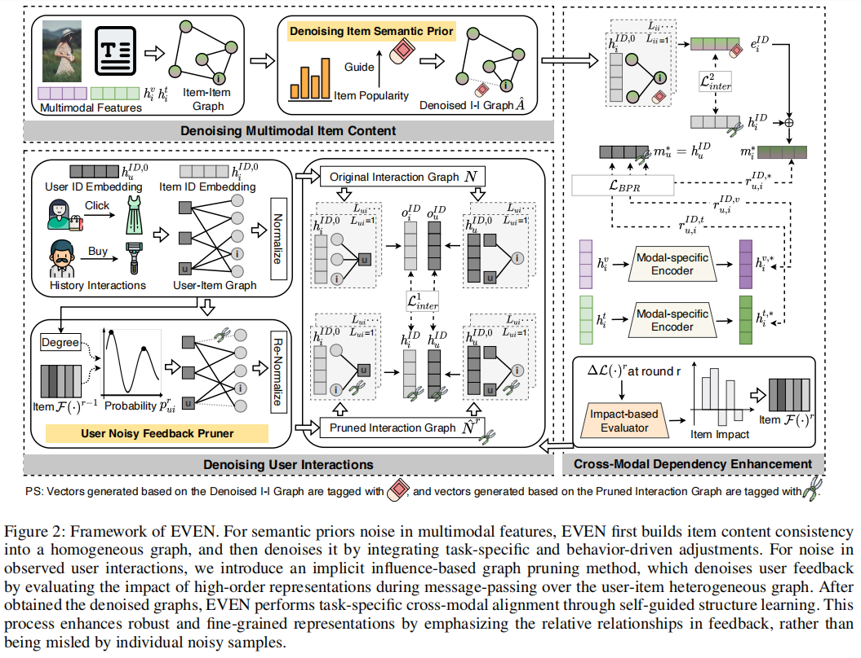
ChongqingUniversity of Technology
ATAI
AdvancedTechniqueof
Artificial Intelligence
ATAI
ChongqingUniversity _{AdvancedTechniqueof}
of Technology Artificial Intelligence
Overview

Slide 4
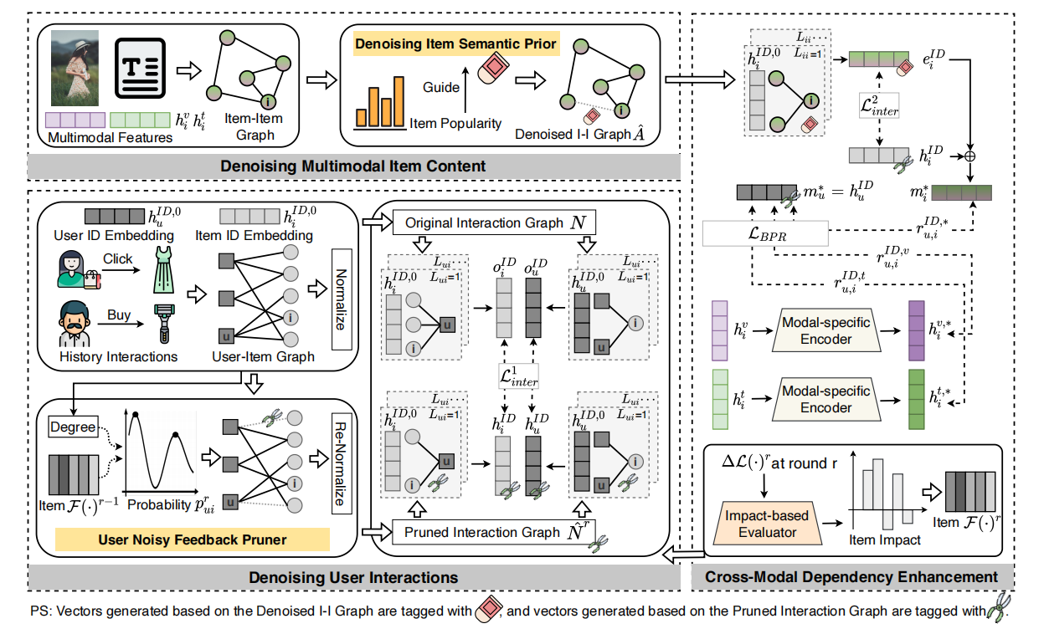
ChongqingUniversity of Technology
ATAI
AdvancedTechniqueof
Artificial Intelligence
ATAI
ChongqingUniversity _{AdvancedTechniqueof}
of Technology Artificial Intelligence
Method
Notes:
行为中的约束，定义了当前的行为节点学习过程不能包含下游行为的语义信息。

Slide 5
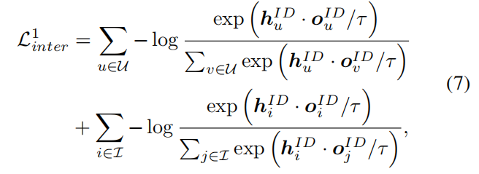
ChongqingUniversity of Technology
ATAI
AdvancedTechniqueof
Artificial Intelligence
ATAI
ChongqingUniversity _{AdvancedTechniqueof}
of Technology Artificial Intelligence
Method

Slide 6
ChongqingUniversity of Technology
ATAI
AdvancedTechniqueof
Artificial Intelligence
ATAI
ChongqingUniversity _{AdvancedTechniqueof}
of Technology Artificial Intelligence
Method

Slide 7
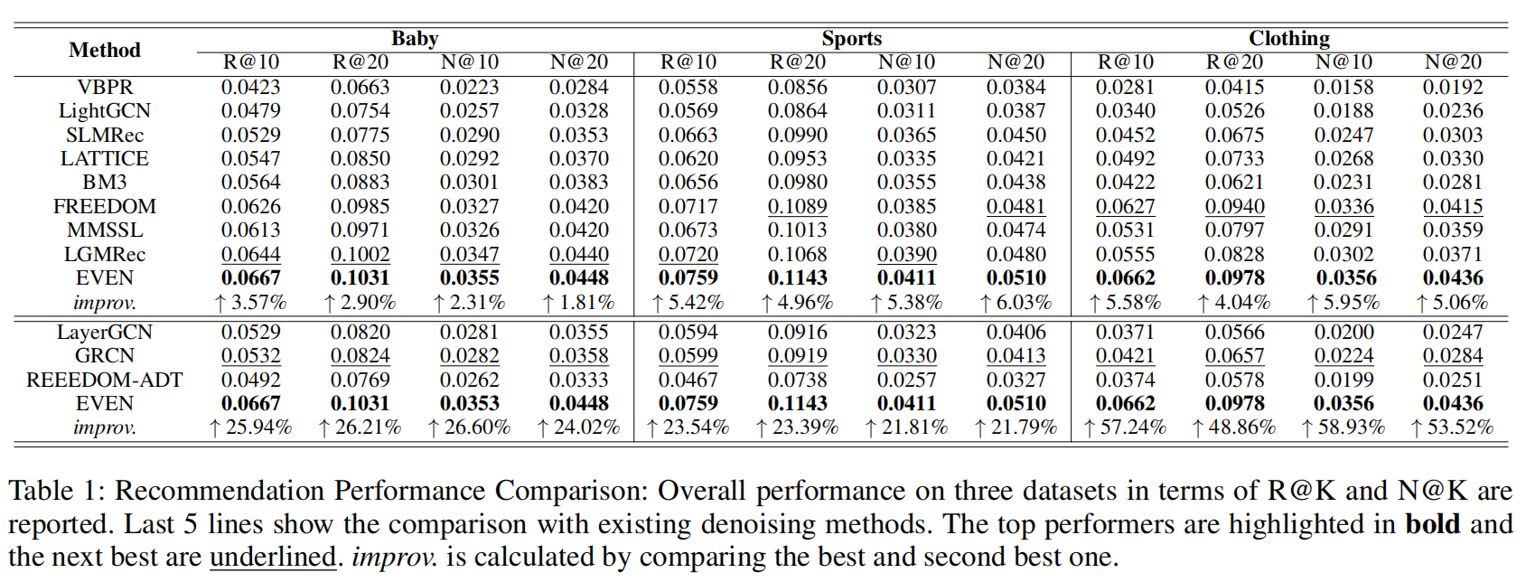
ATAI
AdvancedTechniqueof
Artificial Intelligence
ATAI
ChongqingUniversity _{AdvancedTechniqueof}
of Technology Artificial Intelligence
ChongqingUniversity of Technology
Experiments
Notes:
此外，我们将传统非图神经网络去噪方法ADT适配至多模态推荐系统，选用FREEDOM作为主干网络——因其不会引入额外结构组件而确保对比公平性，该方法记为FREEDOM-ADT。w/o back.：移除反向传播中的改进。
all sg.：在反向传播中使用简单的停止梯度策略。
w/o fit.：移除正向和反向传播中的改进。

Slide 8
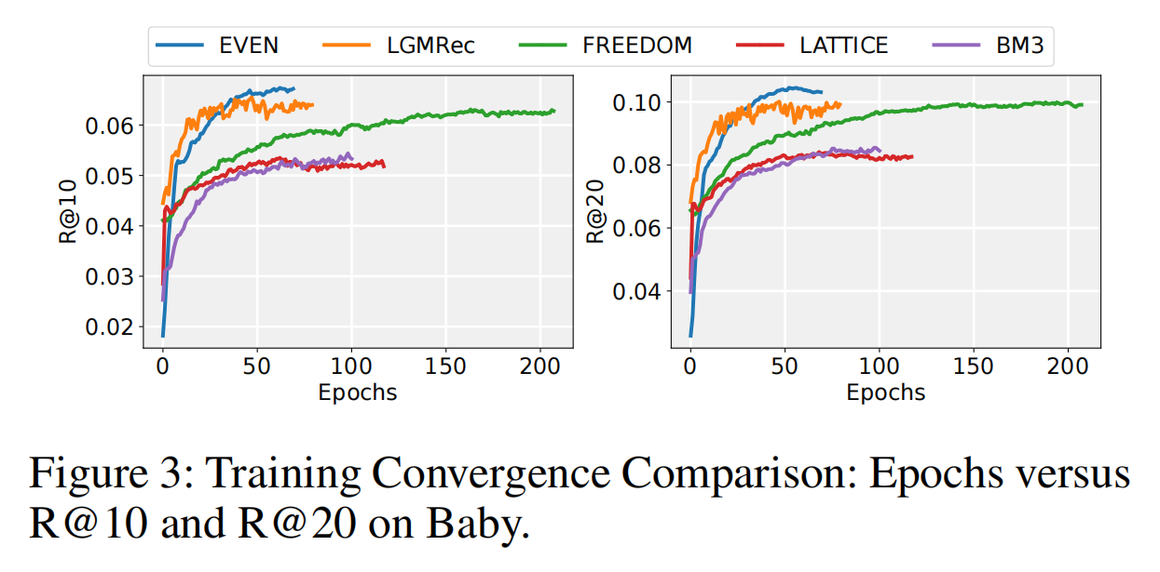
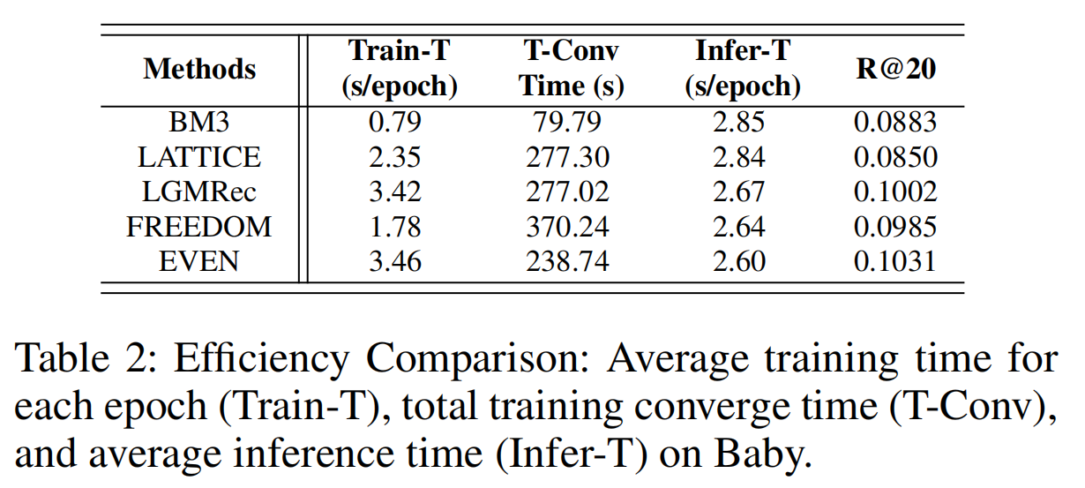
ATAI
AdvancedTechniqueof
Artificial Intelligence
ATAI
ChongqingUniversity _{AdvancedTechniqueof}
of Technology Artificial Intelligence
ChongqingUniversity of Technology
Experiments
Notes:
分析了每个模型在Baby数据集上每轮训练的平均耗时（Train-T）、总收敛时间（T-Conv）以及平均推理时间（Infer-T）。

Slide 9
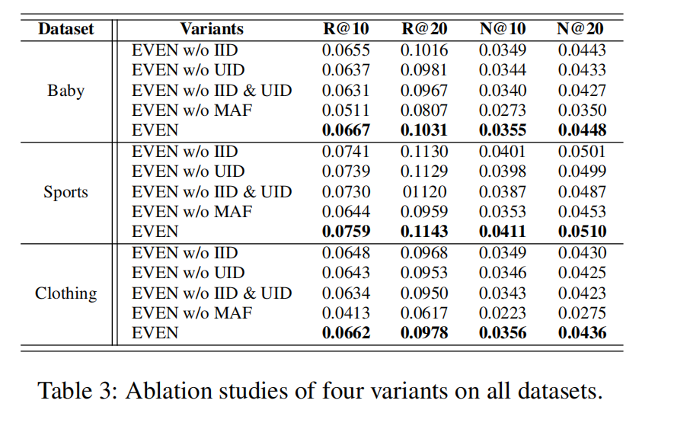
ATAI
AdvancedTechniqueof
Artificial Intelligence
ATAI
ChongqingUniversity _{AdvancedTechniqueof}
of Technology Artificial Intelligence
ChongqingUniversity of Technology
Experiments

Slide 10
ATAI
AdvancedTechniqueof
Artificial Intelligence
ATAI
ChongqingUniversity _{AdvancedTechniqueof}
of Technology Artificial Intelligence
ChongqingUniversity of Technology
Experiments

Slide 11
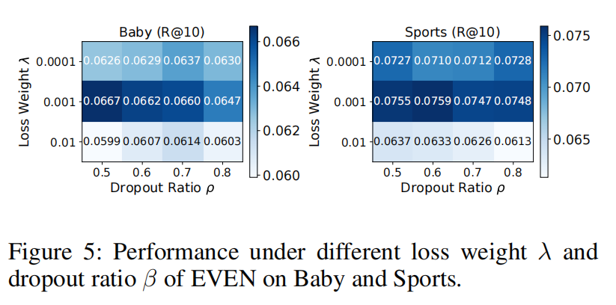
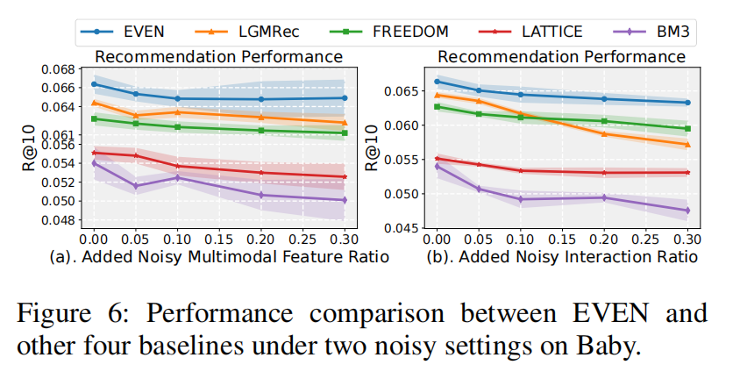
ATAI
AdvancedTechniqueof
Artificial Intelligence
ATAI
ChongqingUniversity _{AdvancedTechniqueof}
of Technology Artificial Intelligence
ChongqingUniversity of Technology
Experiments

Slide 12
ChongqingUniversity of Technology
ATAI
AdvancedTechniqueof
Artificial Intelligence
ATAI
ChongqingUniversity _{AdvancedTechniqueof}
of Technology Artificial Intelligence
Thanks!

